Slide 1
Servlet
By : Jatin Ambasana

Slide 2
Introduction
In the early days, web servers deliver static contents that are in different to users' requests.
Java servlets typically run on the HTTP protocol. HTTP is an request-response protocol. The client sends a request message to the server, and the server returns a response message as illustrated.
Java servlets are server-side programs (running inside a web server) that handle clients' requests and return a customized or dynamic response for each request.

Slide 3
Cont.
Why Build Web Pages Dynamically?
The Web page is based on data submitted by the user
E.g., results page from search engines and order-confirmation pages at on-line stores
The Web page is derived from data that changes frequently
E.g., a weather report or news headlines page

Slide 4
Cont.
The Web page uses information from databases or other server-side sources
E.g., an e-commerce site could use a servlet to build a Web page that lists the current price and availability of each item that is for sale.
Java servlet is the foundation of the Java server-side technology, JSP (JavaServer Pages), JSF (JavaServer Faces), Struts, Spring, Hibernate, and others, are extensions of the servlet technology.

Slide 5
Cont.
Big applets require long download time
Applets do not have access to all the system resources
Server-side Java solves problems that applets face
Code executed on the server side and only the results sent to client
Servlets can access applications and data sources

Slide 6
Cont.
Servlets are extensions to Java-enabled servers
Servlet is a dynamically loaded module that services requests from a Web server
Servlets are executed within the Java Virtual Machine
Because the servlet is running on the server side, it does not depend on browser compatibility

Slide 7
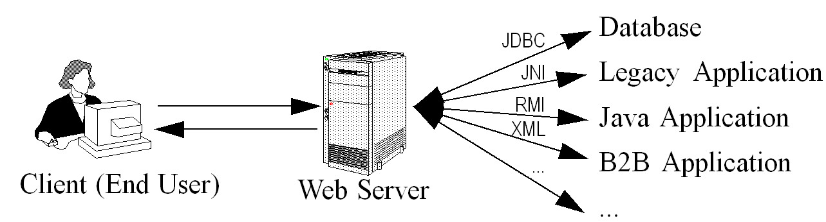
A Servlet’s Job
Read data sent by client (form data)
Read data sent by client (request headers)
Generate the results
Send the explicit data back to client (HTML)
Send the implicit data to client (status codes and response headers)

Slide 8
Servlet vs CGI
Java Servlets often serve the same purpose as programs implemented using the Common Gateway Interface (CGI). But Servlets offer several advantages in comparison with the CGI.
Performance is significantly better.
Servlets execute within the address space of a Web server. It is not necessary to create a separate process to handle each client request.

Slide 9
Cont.
Servlets are platform-independent because they are written in Java.
Java security manager on the server enforces a set of restrictions to protect the resources on a server machine. So servlets are trusted.
The full functionality of the Java class libraries is available to a servlet. It can communicate with applets, databases, or other software via the sockets and RMI mechanisms that you have seen already.

Slide 10
Advantages of Servlets
Efficiency
More efficient – uses lightweight java threads as opposed to individual processes
Persistency
Servlets remain in memory
Servlets can maintain state between requests
Portability
Since servlets are written in Java, they are platform independent
Robustness
Error handling, Garbage collector to prevent problems with memory leaks
Large class library – network, file, database, distributed object components, security, etc.

Slide 11
Cont.
Extensibility
Creating new subclasses that suite your needs
Inheritance, polymorphism, etc.
Security
Security provided by the server as well as the Java Security Manager
Powerful
Servlets can directly talk to web server
Facilitates database connection pooling, session tracking etc.
Convenient
Parsing and decoding HTML form data, reading and setting HTTP headers, handling cookies, etc.

Slide 12
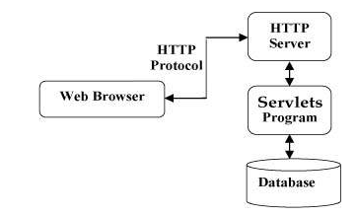
Java Servlet Architecture

Slide 13
Cont.
Two packages make up the servlet architecture
javax.servlet
Contains generic interfaces and classes that are implemented and extended by all servlets
javax.servlet.http
Contains classes that are extended when creating HTTP-specific servlets
The heart of servlet architecture is the interface class javax.servlet.Servlet
It provides the framework for all servlets
Defines five basic methods – init, service, destroy, getServletConfig and getServletInfo

Slide 14
Life cycle
A servlet life cycle can be defined as the entire process from its creation till the destruction.
The servlet is initialized by calling the init () method.
The servlet calls service() method to process a client's request.
The servlet is terminated by calling the destroy() method.
Finally, servlet is garbage collected by the garbage collector of the JVM.

Slide 15
Cont.
init() method :
The init method is designed to be called only once. It is called when the servlet is first created, and not called again for each user request.
So, it is used for one-time initializations, just as with the init method of applets.
The servlet is normally created when a user first invokes a URL corresponding to the servlet, but you can also specify that the servlet be loaded when the server is first started.

Slide 16
Cont.
When a user invokes a servlet, a single instance of each servlet gets created, with each user request resulting in a new thread that is handed off to doGet or doPost as appropriate.
The init() method simply creates or loads some data that will be used throughout the life of the servlet.
public void init() throws ServletException {
// Initialization code...
}

Slide 17
Cont.
service() method :
The service() method is the main method to perform the actual task.
The servlet container (i.e. web server) calls the service() method to handle requests coming from the client( browsers) and to write the formatted response back to the client.
Each time the server receives a request for a servlet, the server spawns a new thread and calls service.

Slide 18
Cont.
The service() method checks the HTTP request type (GET, POST, PUT, DELETE, etc.) and calls doGet, doPost, doPut, doDelete, etc. methods as appropriate.
public void service(ServletRequest request,
ServletResponse response)
throws ServletException, IOException{
}

Slide 19
Cont.
destroy() method :
The destroy() method is called only once at the end of the life cycle of a servlet.
This method gives your servlet a chance to close database connections, halt background threads, write cookie lists or hit counts to disk, and perform other such cleanup activities.
After the destroy() method is called, the servlet object is marked for garbage collection. The destroy method definition looks like this:
public void destroy() {
// Finalization code... }

Slide 20
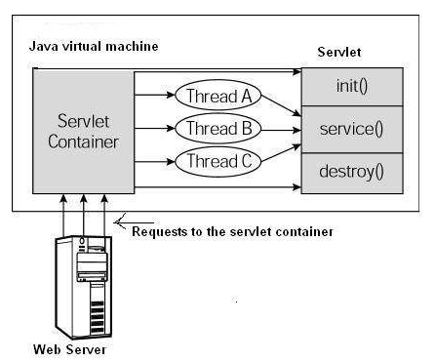
Architecture Diagram
The following figure depicts a typical servlet life-cycle scenario.

Slide 21
Cont.
First the HTTP requests coming to the server are delegated to the servlet container.
The servlet container loads the servlet before invoking the service() method.
Then the servlet container handles multiple requests by spawning multiple threads, each thread executing the service() method of a single instance of the servlet.

Slide 22
Servlet API
The javax.servlet and javax.servlet.http packages represent interfaces and classes for servlet api.
The javax.servlet package contains many interfaces and classes that are used by the servlet or web container. These are not specific to any protocol.
The javax.servlet.http package contains interfaces and classes that are responsible for http requests only.

Slide 23
Cont.
There are many interfaces in javax.servlet package. They are as follows:
Servlet
ServletRequest, ServletResponse
RequestDispatcher
ServletConfig, ServletContext
SingleThreadModel
Filter, FilterConfig, FilterChain

Slide 24
Cont.
There are many classes in javax.servlet package. They are as follows:
GenericServlet
ServletInputStream, ServletOutputStream
ServletRequestWrapper, ServletResponseWrapper
ServletRequestEvent, ServletContextEvent

Slide 25
GenericServlet class
GenericServlet class implements Servlet, ServletConfig and Serializable interfaces. It provides the implementation of all the methods of these interfaces except the service method.
GenericServlet class can handle any type of request so it is protocol-independent.
public void init(ServletConfig config) is used to initialize the servlet.
public abstract void service(ServletRequest request, ServletResponse response) provides service for the incoming request. It is invoked at each time when user requests for a servlet.

Slide 26
Cont.
public void destroy() is invoked only once throughout the life cycle and indicates that servlet is being destroyed.
public ServletConfig getServletConfig() returns the object of ServletConfig.
public String getServletInfo() returns information about servlet such as writer, copyright, version etc.

Slide 27
HttpServlet class
The HttpServlet class extends the GenericServlet class and implements Serializable interface. It provides http specific methods such as doGet, doPost, doHead, doTrace etc.
Methods of HttpServlet class
public void service(ServletRequest req,ServletResponse res) dispatches the request to the protected service method by converting the request and response object into http type.

Slide 28
Cont.
protected void service(HttpServletRequest req, HttpServletResponse res) receives the request from the service method, and dispatches the request to the doXXX() method depending on the incoming http request type.
protected void doGet(HttpServletRequest req, HttpServletResponse res) handles the GET request. It is invoked by the web container.

Slide 29
Cont.
protected void doPost(HttpServletRequest req, HttpServletResponse res) handles the POST request. It is invoked by the web container.
protected void doHead (HttpServletRequest req, HttpServletResponse res) handles the HEAD request. It is invoked by the web container.

